Slide 1
Insertion Sort
Comparison Sort Technique

Slide 2
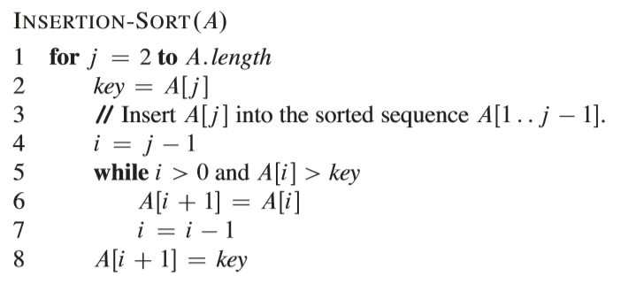

Slide 3
A₁
15
14
11
9
7
6
4
3
Worst Case
A₂
1
2
3
5
4
8
7
6
Average Case
A₃
3
14
11
9
7
6
4
15
Etc.
A₄
1
2
3
4
5
6
7
8
Best Case

Slide 4
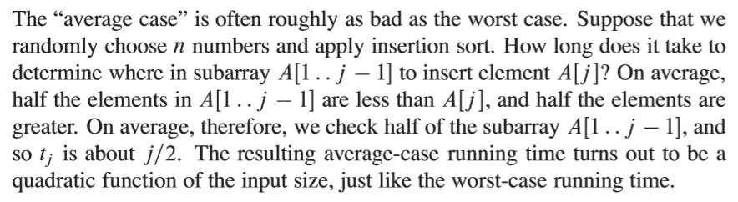
A₁
15
14
11
9
7
6
4
3
Worst Case
A₂
1
2
3
5
4
8
7
6
Average Case
A₃
3
14
11
9
7
6
4
15
Etc.

Slide 5
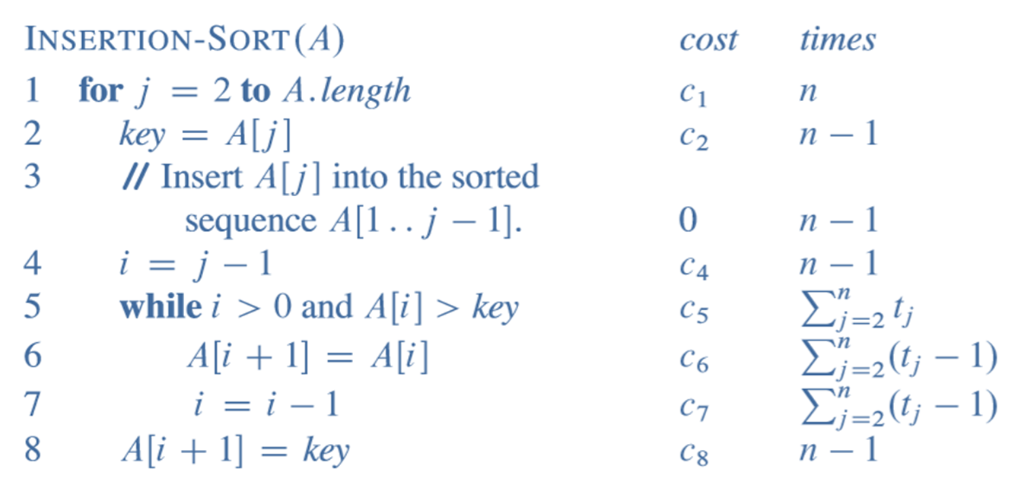
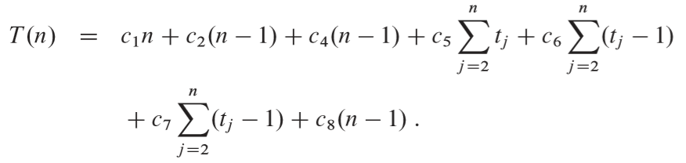

Slide 6
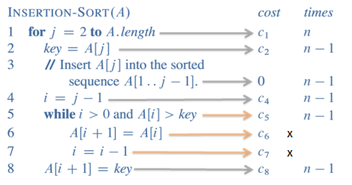
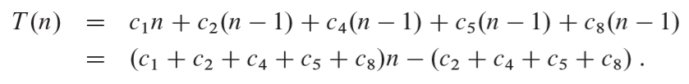
= an + b
Where a & b are constants

Slide 7
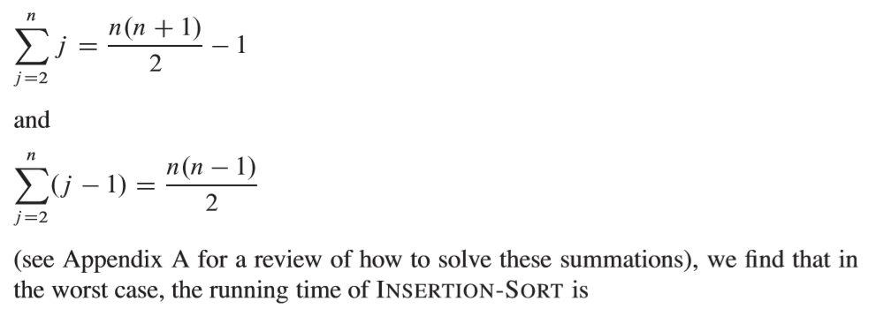
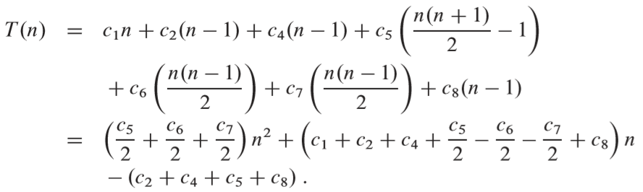
= an² + bn + c
Where a, b & c are constants

Slide 8
Best Case running time
T(n) = an + b
Average Case running time
T(n) = an² + bn + c
Worst Case running time

